Slide 1
MUSIC WEB APPLICATIONS USING DJANGO FRAMEWORK
JAYALAKSHMI .S
Au412321104024
SRI RAMANUJAR ENGINEERING COLLEGE

Slide 2
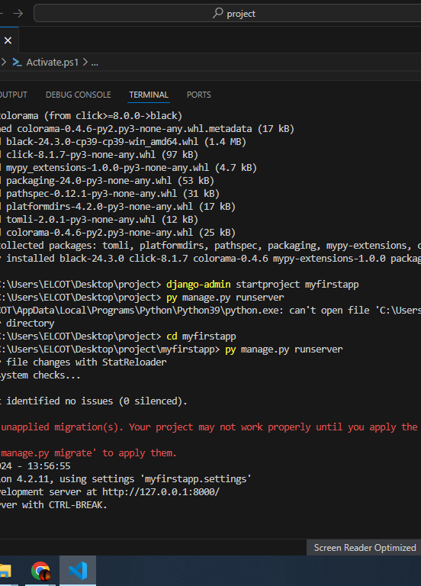
Step 1
Set Up Your Django Environment:
Install Python if you haven't already.
Install Django using pip:

Slide 3
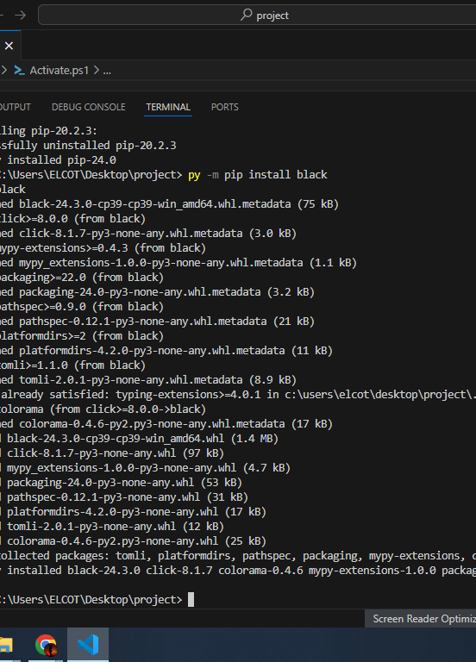
Install Django
Using Django command to install django

Slide 4
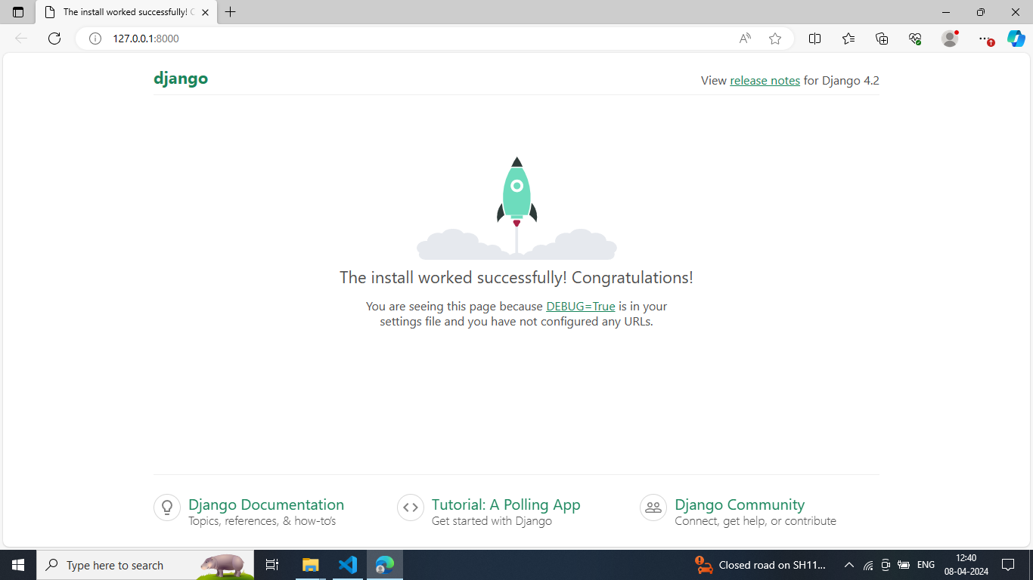
Dijango downloaded successfully

Slide 5
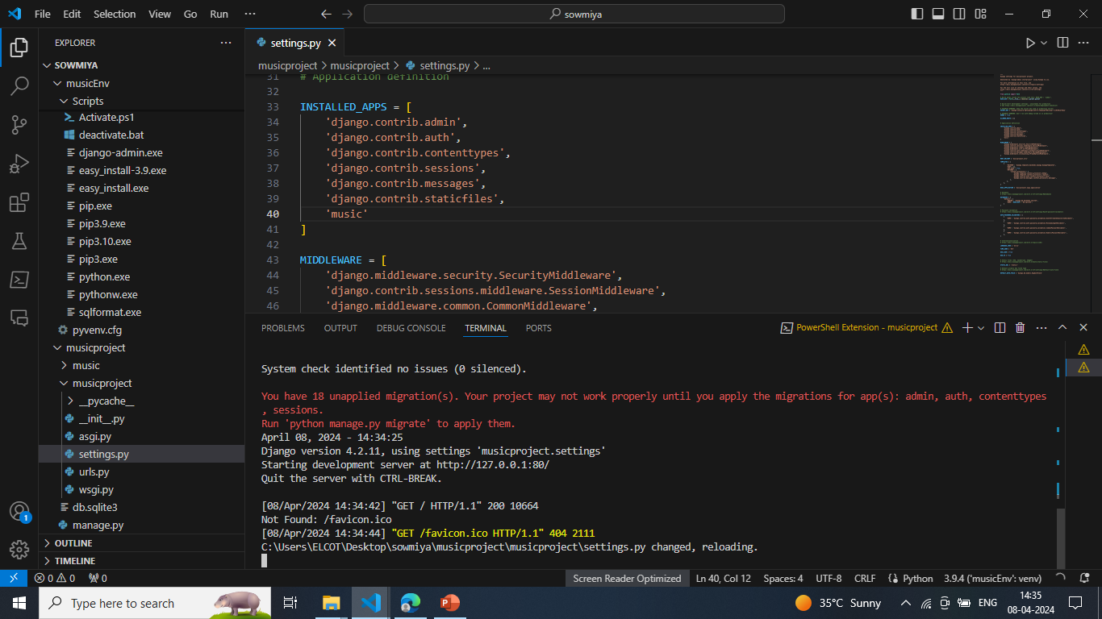
INSERT ‘MUSIC’ COMMAND IN INSTALLED_APPS

Slide 6
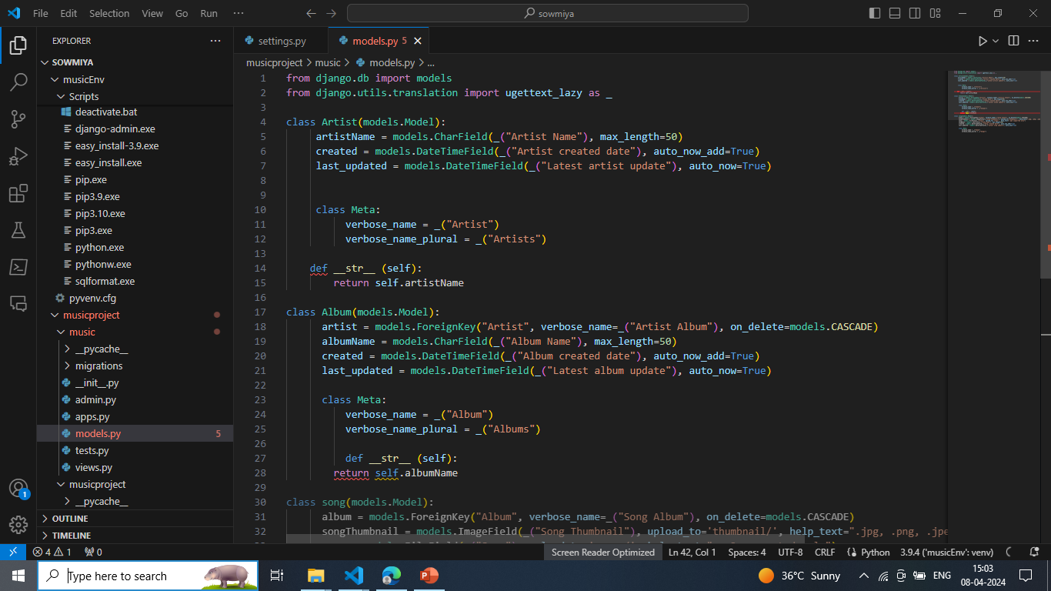
Import modules in models.py
And write code for various classes

Slide 7
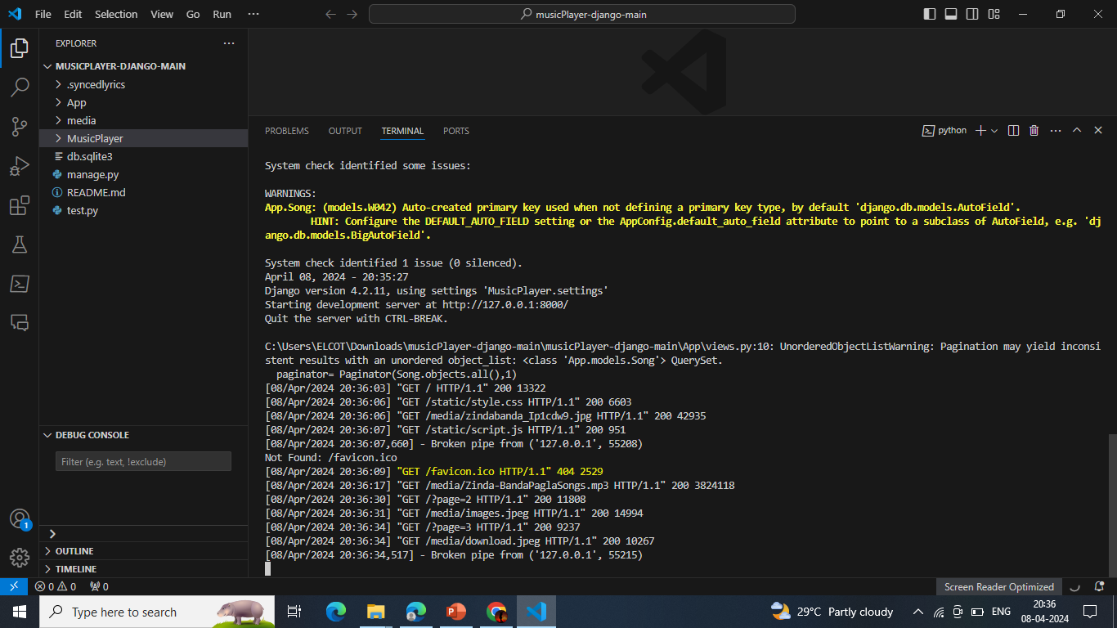

Slide 8
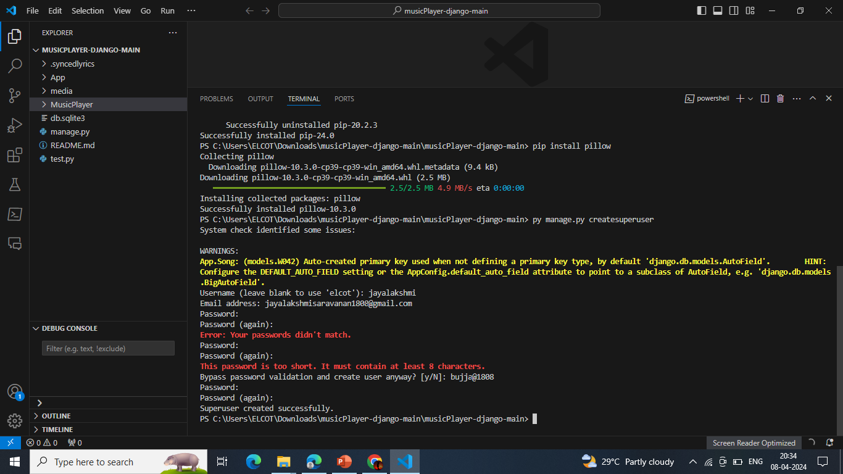
CREATE USER NAME AND PASSWORD

Slide 9
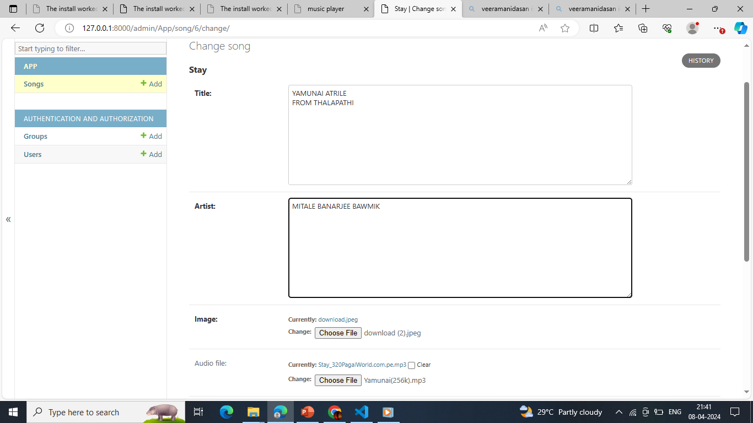
ADD SONGS IN DJANGO APPLICATIONS

Slide 10
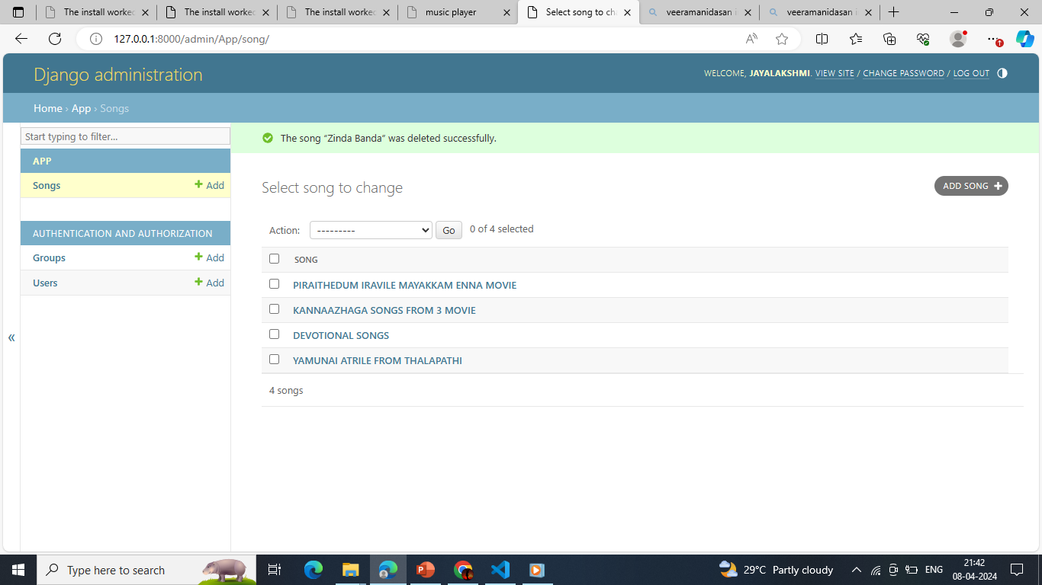
BY THIS SAME METHOD ADD MORE SONGS

Slide 11
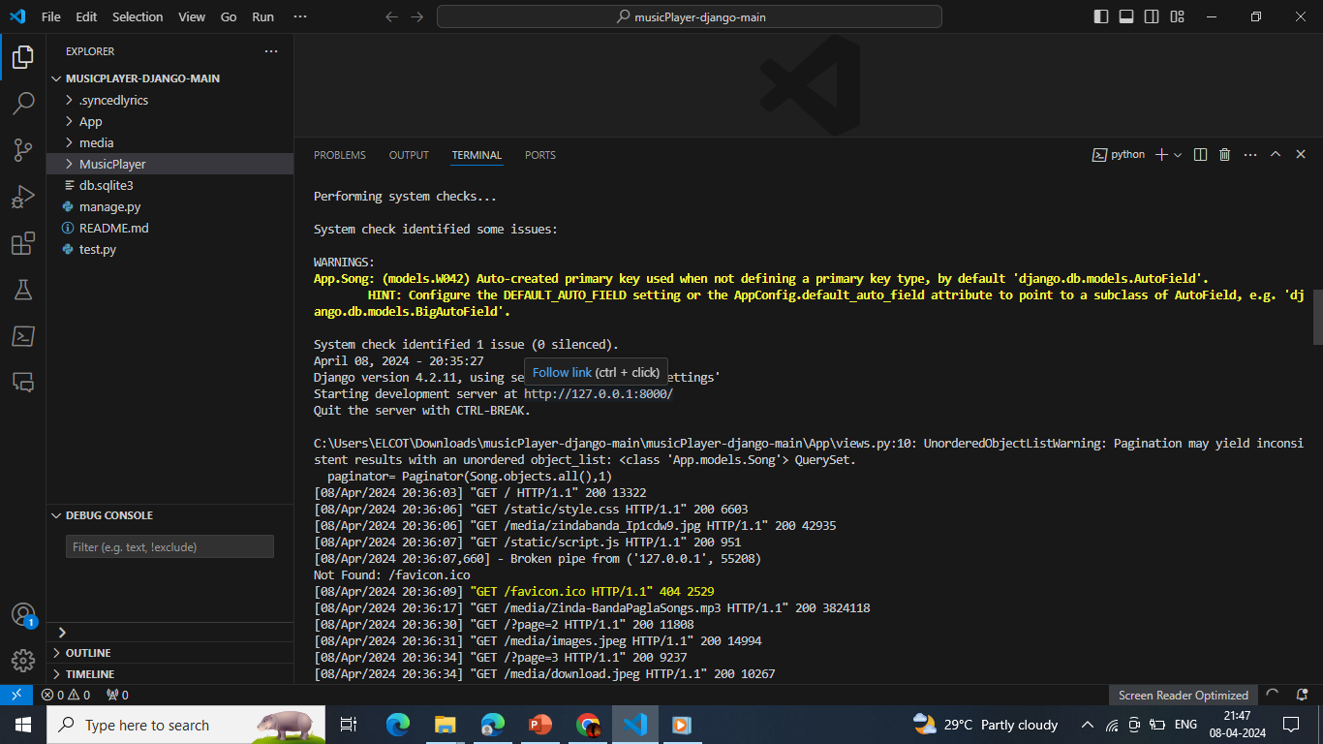
CLICK THE FOLLOW LINK OPTION ABOVE THE LINK HTTP://127.0.0.1:8000

Slide 12
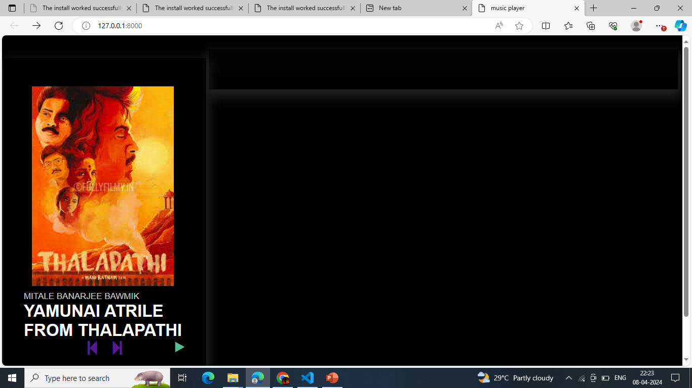
APPLICATIONS IS EXECUTED SUCCESSFULLY

Slide 13
Set Up Your Django Environment:
Install Python if you haven't already.
Install Django using pip:
pip install django
Create a new Django project:
django-admin startproject music_app
Create Django App for Music:
Inside your project directory, create a new Django app for managing music-related functionalities:
bash
cd music_app python manage.py startapp music
Define Models:
Define Django models to represent your music-related data (e.g., Songs, Artists, Albums). Edit the models.py file in your music app.
Set Up Database:
Configure your database settings in settings.py. By default, Django uses SQLite, but you can configure it to use other databases like PostgreSQL, MySQL, etc.
Migrate Database:
Run migrations to create database tables based on your models:
python manage.py makemigrations python manage.py migrate
Create Views:
Define views to handle HTTP requests and render appropriate responses. Views are typically defined in views.py within your app directory.
Create URLs:
Map URLs to your views using URL patterns. Define URL patterns in urls.py within your app directory.

Slide 14
Implement Templates:
Create HTML templates to render user interfaces. Templates are typically stored in a directory named templates within your app directory.
Handle User Authentication (if needed):
Implement user authentication if your application requires user accounts, login, and registration functionalities.
Implement Business Logic:
Implement logic for managing music data, such as adding, editing, and deleting songs, artists, or albums.
Serve Static Files:
Configure Django to serve static files like CSS, JavaScript, and images in development mode.
Test Your Application:
Test your application thoroughly to ensure all functionalities work as expected.
Deploy Your Application (Optional):
Once you're satisfied with your application, deploy it to a production server. You can use platforms like Heroku, AWS, or DigitalOcean.
Monitor and Maintain:
Monitor your application's performance and user feedback. Regularly update and maintain your application to fix bugs and add new features.
Remember, this is a simplified guide. Depending on the complexity of your music application, you may need to dive deeper into Django's features and explore additional libraries and tools to enhance your project

Slide 15
USER NAME :Jayalakshmi
Password : bujja@1808
Thankyou

